Slide 1


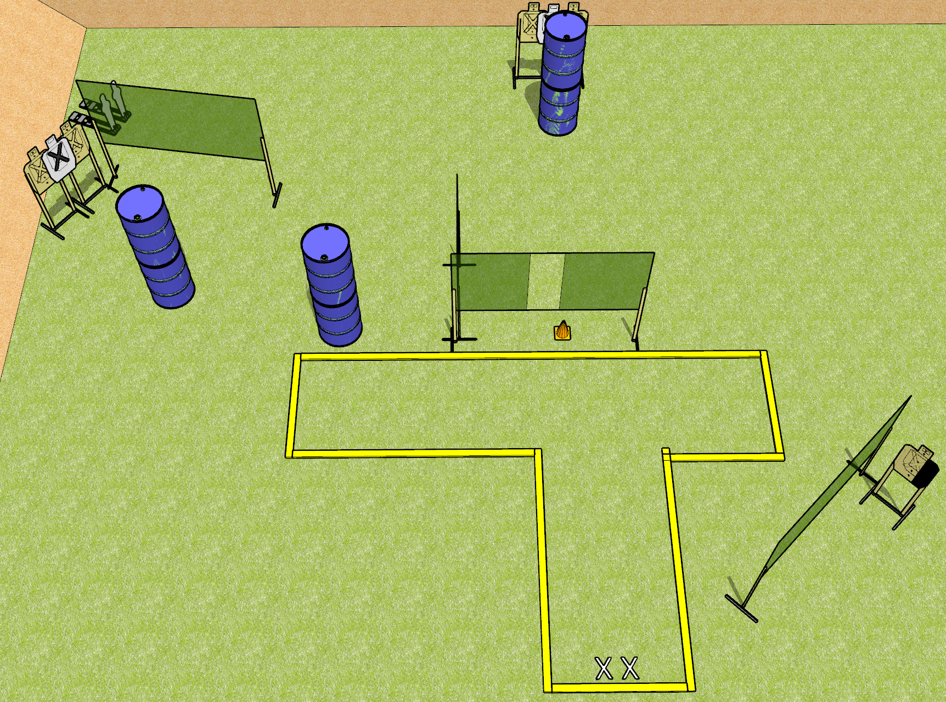
 | Dothan Gun Club – USPSA Match Dot the I Course Designer : Drew Coleman
START POSITION : Standing with both feet on X’s, facing uprange, wrists above respective shoulders.
GUN READY CONDITION : Pistol loaded and holstered. PCC safety on, buttstock on belt, pointed at orange cone |  | SCORING: Comstock, 12 rounds TARGETS: 5 paper, 2 Steel SCORED HITS: Best 2 on paper, steel until down START-STOP: Audible, last shot RULES:
STAGE PROCEDURE: Engage targets as they become available from within the fault lines

Slide 2

Notes: T1 should be visible from left corner from start marks. T2 should not. T1 should not be visible from right corner from start marks but T2 should. T1 and T2 should not be visible at the same time from any position
T3 should be visible from the back of the shooting area, through the window and should not be visible at the same time as T4.

